Slide 1



DESIGN OF EXPERIMENTS
Team 212
Aishwarya Rai
Nikhil
Quinn Yen
Pramit Piyush Patel
Siddharth Holankar
Shuairun

Slide 2



Objective
Optimize the car's performance by analyzing key design factors.
Length of the car
Size of the wheels
Weight of the engine
Placement of the windshield (aerodynamics)
Steering wheel position
Use factorial design to identify cost-effective improvements.
Goal: Maximize travel distance while minimizing expenses.
Strive for a balance between performance and cost efficiency.

Slide 3


Experiment Layout
Response Variable = Distance travelled by car in cm
Racetrack to measure response variable set at an angle of 30 degree
Equipment used: woodblock, books, measuring tape
Factors = 5
One replication consisting of 16 runs

Slide 4





Factors
Wheel size
Type of the wheels in front & rear (small or large)
Weight of the Engine
Weight of the engine is placed on the car in the front or rear
Length of the Car
Difference of distance between front and rear axles of the car
Windshield
Position of windshield front or rear
Steering Wheel Placement
Location of steering wheel front or rear

Slide 5


Level of factors
Factor | Low (-) | High (+)
Length of the car | 8 cms | 16 cms
Wheel size | Small wheels in both front and rear | Big wheels in both front and rear
Weight of engine | Light (2 blocks) | Heavy (5 blocks)
Windshield | Front | Rear
Steering Wheel Placement | Rear | Front

Slide 6

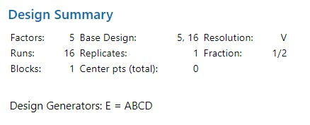

Factorial Design
Factors = 5
One replication (n=1) consisting of 16 runs
Total runs / observations = 16
Noise factors such as change in ramp angle, durability of the car, friction from floor surface were reduced by leveler, conducting runs in 1 block and same member running the car
A = Length of the car
B = Wheel size
C = Engine weight
D = Windshield placement
E = Steering wheel placement

Slide 7

Initial Model

Slide 8
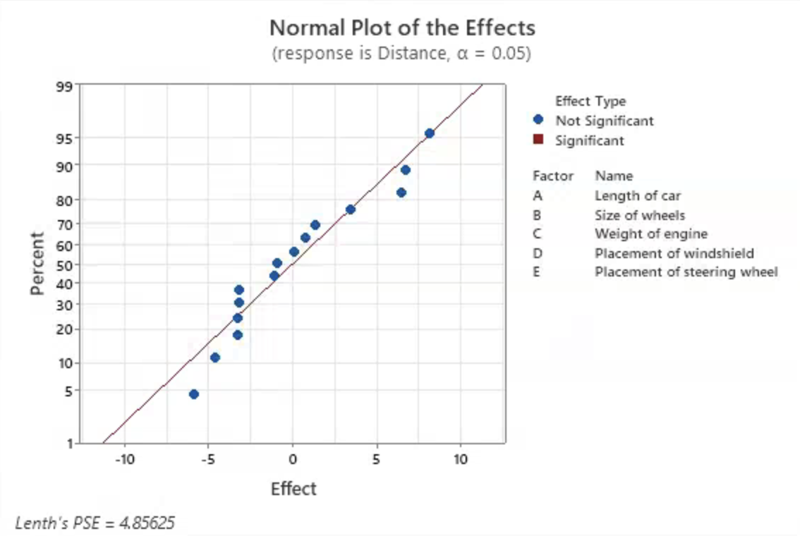
None of the factors or interactions are identified as statistically significant at α = 0.05 since all points closely follow the reference line. This indicates that the initial model overfits the data, masking true significant effects.

Slide 9
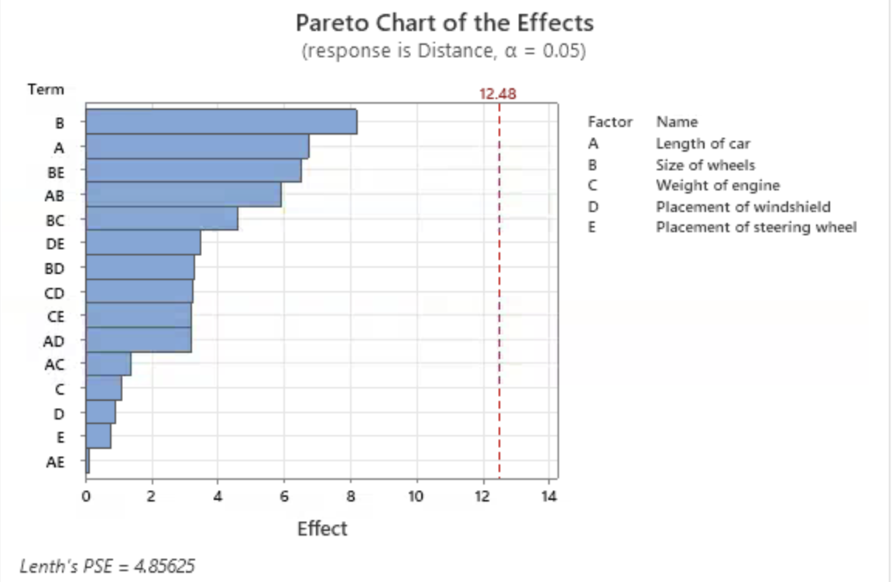
The Pareto chart shows factors B, A, and interaction BE significantly affect distance. These should be prioritized for optimization.
We had checked the accuracy by deleting interactions in the ascending order from bottom to top.

Slide 10
Final Model

Slide 11
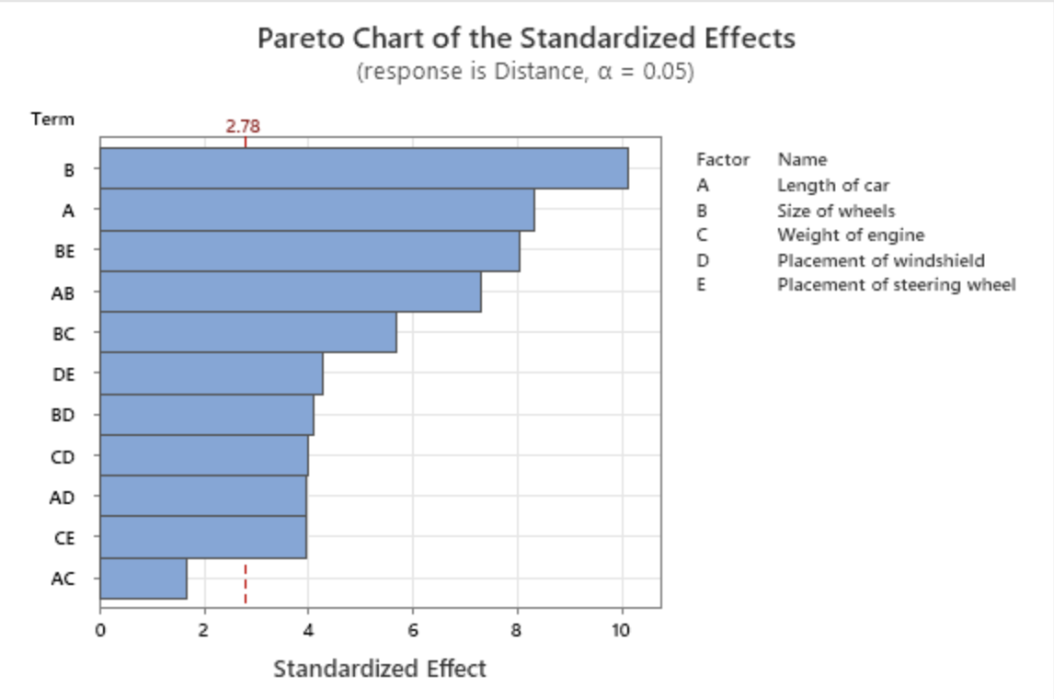
The final model shows B, A, and BE as significant factors influencing distance, exceeding the threshold (2.78).

Slide 12
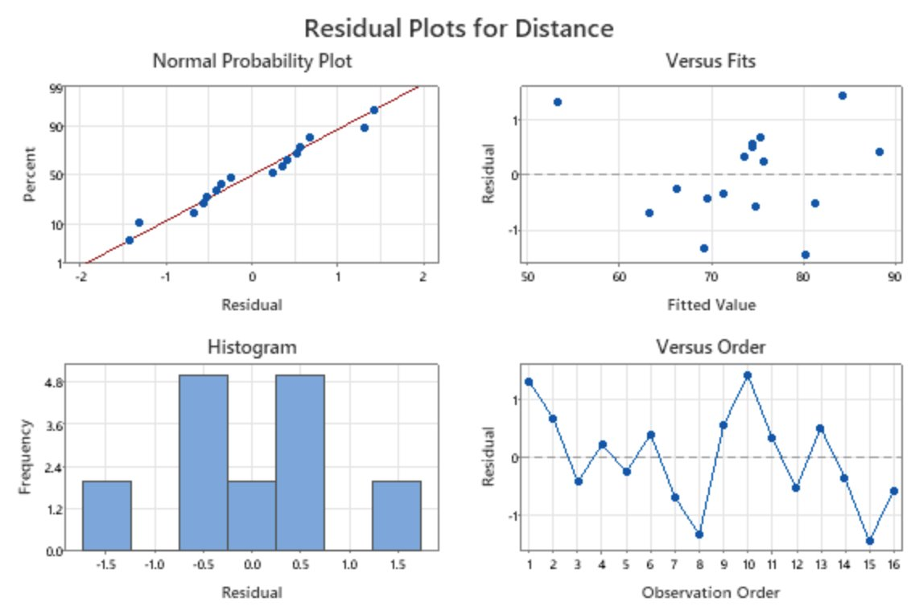
The residual plots indicate that the residuals are approximately normally distributed (Normal Probability Plot) and have no clear pattern against fitted values (Versus Fits) or observation order (Versus Order), confirming the model's assumptions. The histogram shows a symmetric distribution, supporting model validity.​

Slide 13
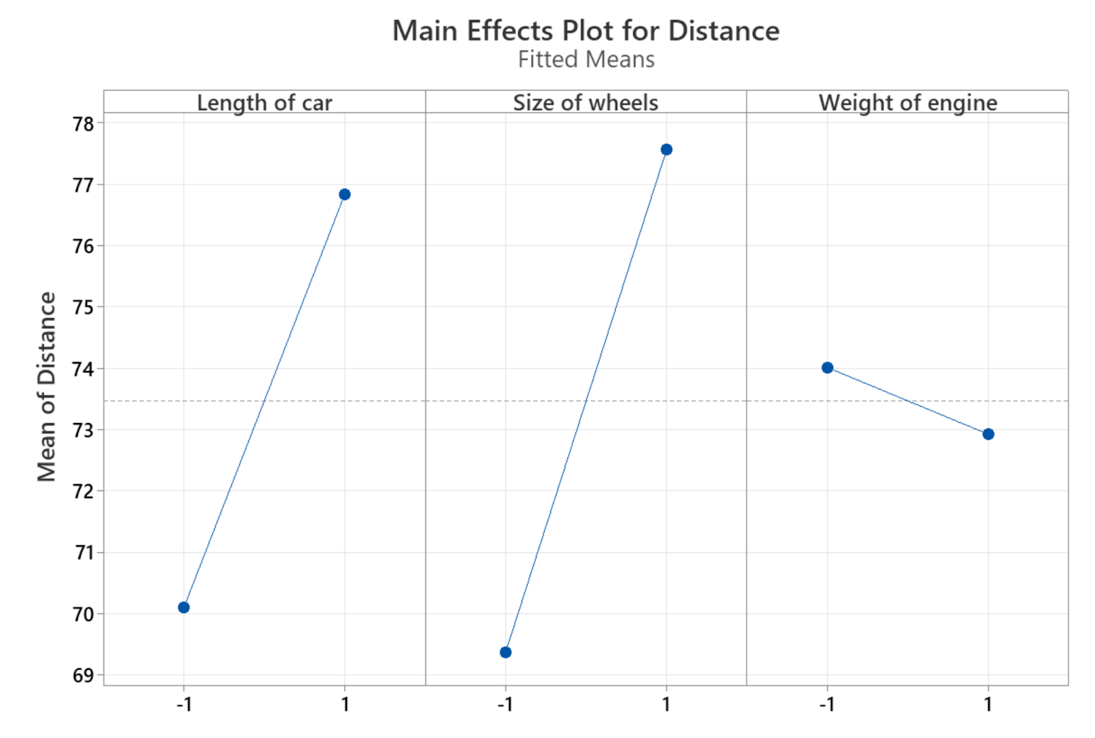
The main effects plot shows that length of car and size of wheels have a strong positive impact on distance, as indicated by steep slopes. Conversely, weight of engine has a slight negative impact. These factors should be considered when optimizing for maximum distance.

Slide 14
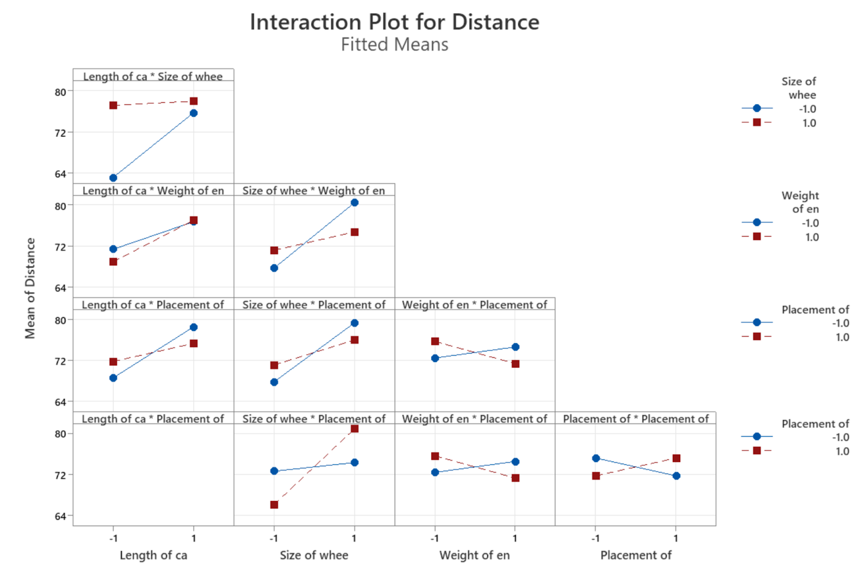
The interaction plot shows significant interactions between factors, particularly between length of car and size of wheels, size of wheels and placement of steering wheel, as indicated by the non-parallel lines. These interactions significantly influence the mean distance and should be considered in optimization.

Slide 15
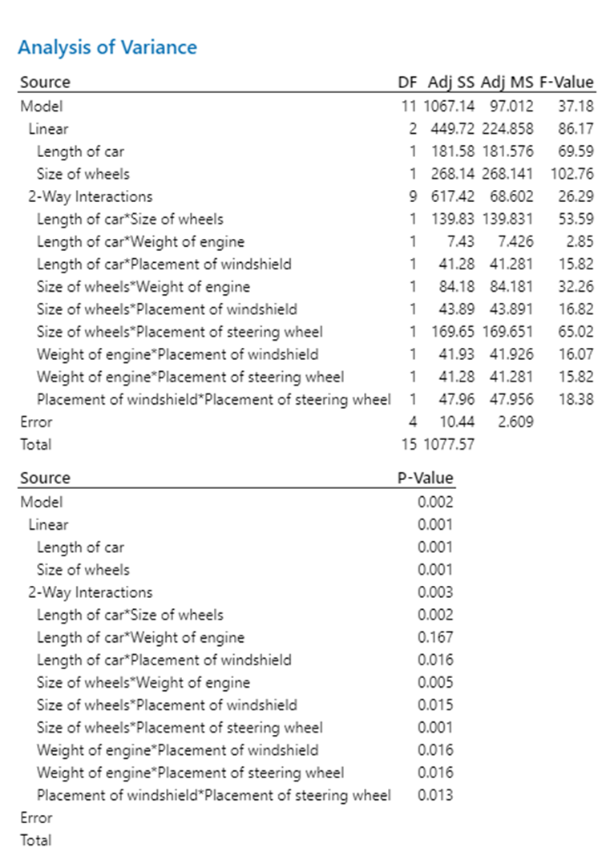
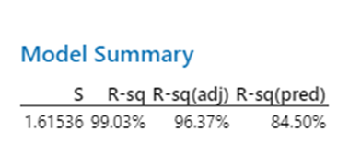
The ANOVA table highlights significant predictors and interactions:
Key Predictors: Length of car and size of wheels (p=0.001 each) are highly significant.
Interactions: Length of car × size of wheels (p=0.002) and size of wheels × weight of engine (p=0.005) show strong effects.
Model Summary:
R²: 99.03% (excellent fit).
Adjusted R²: 96.37% (robust).
Predicted R²: 84.50% (strong predictive power).

Slide 16
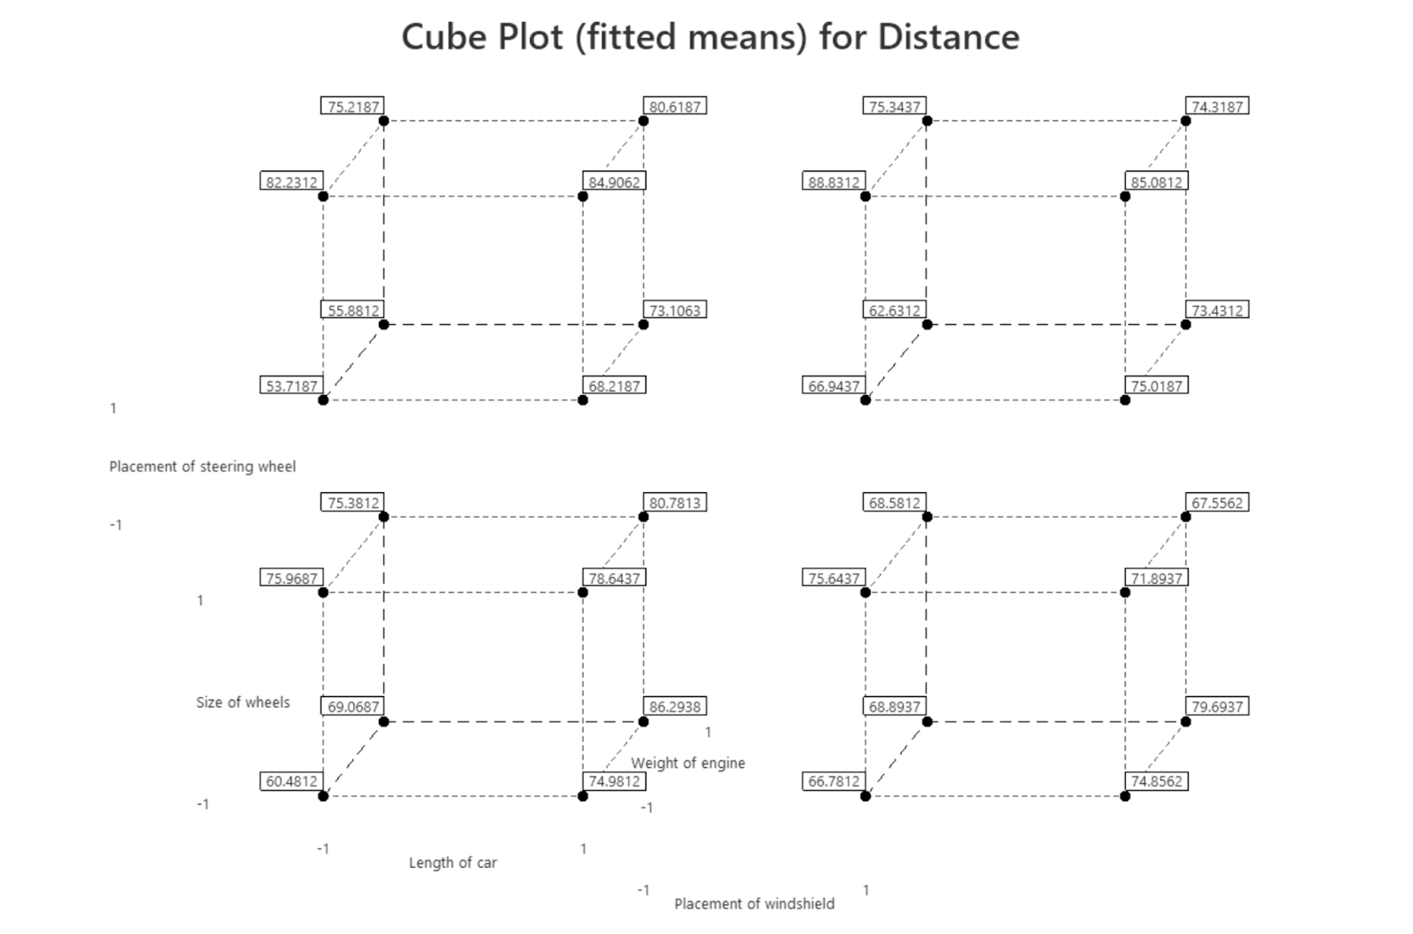
The cube plot illustrates the fitted means of distance for various combinations of factors. It highlights that combinations involving higher values of length of car, size of wheels, and placement of steering wheel yield higher distances. These optimal settings should be targeted to achieve maximum performance.

Slide 17
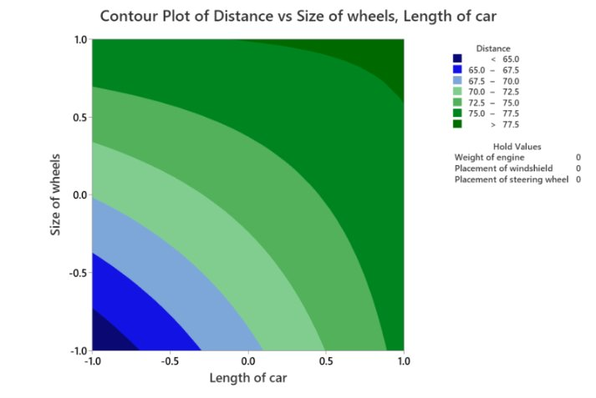
The contour plot shows the relationship between size of wheels and length of car on distance. Higher values of both variables lead to greater distances, as indicated by the darker green regions. Optimizing these factors can maximize distance.​

Slide 18
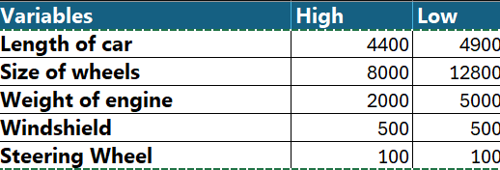
This table show the cost of every variable on both level. Cost of the wheel is the biggest factor for the car cost. Windshield and Steering wheel does not affect the changes in cost.

Slide 19
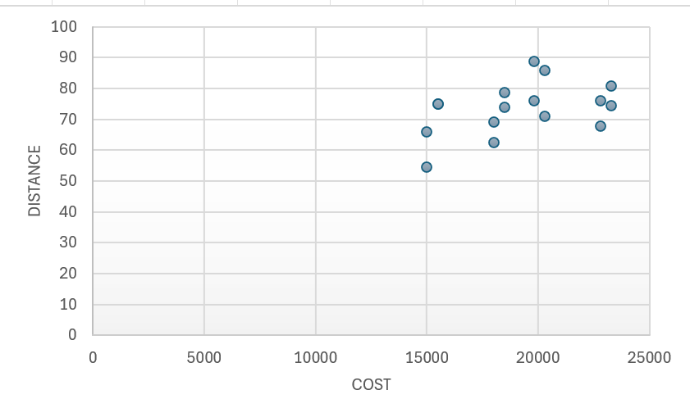
This graph shows a positive trend between car cost and distance. The best-performing car achieves the highest distance of 88.7 units at a cost of 19,800, making it the most efficient choice. Most cars cluster between 70–85 units of distance and 15,000–23,300 in cost, with engine weight and wheel length influencing performance.

Slide 20
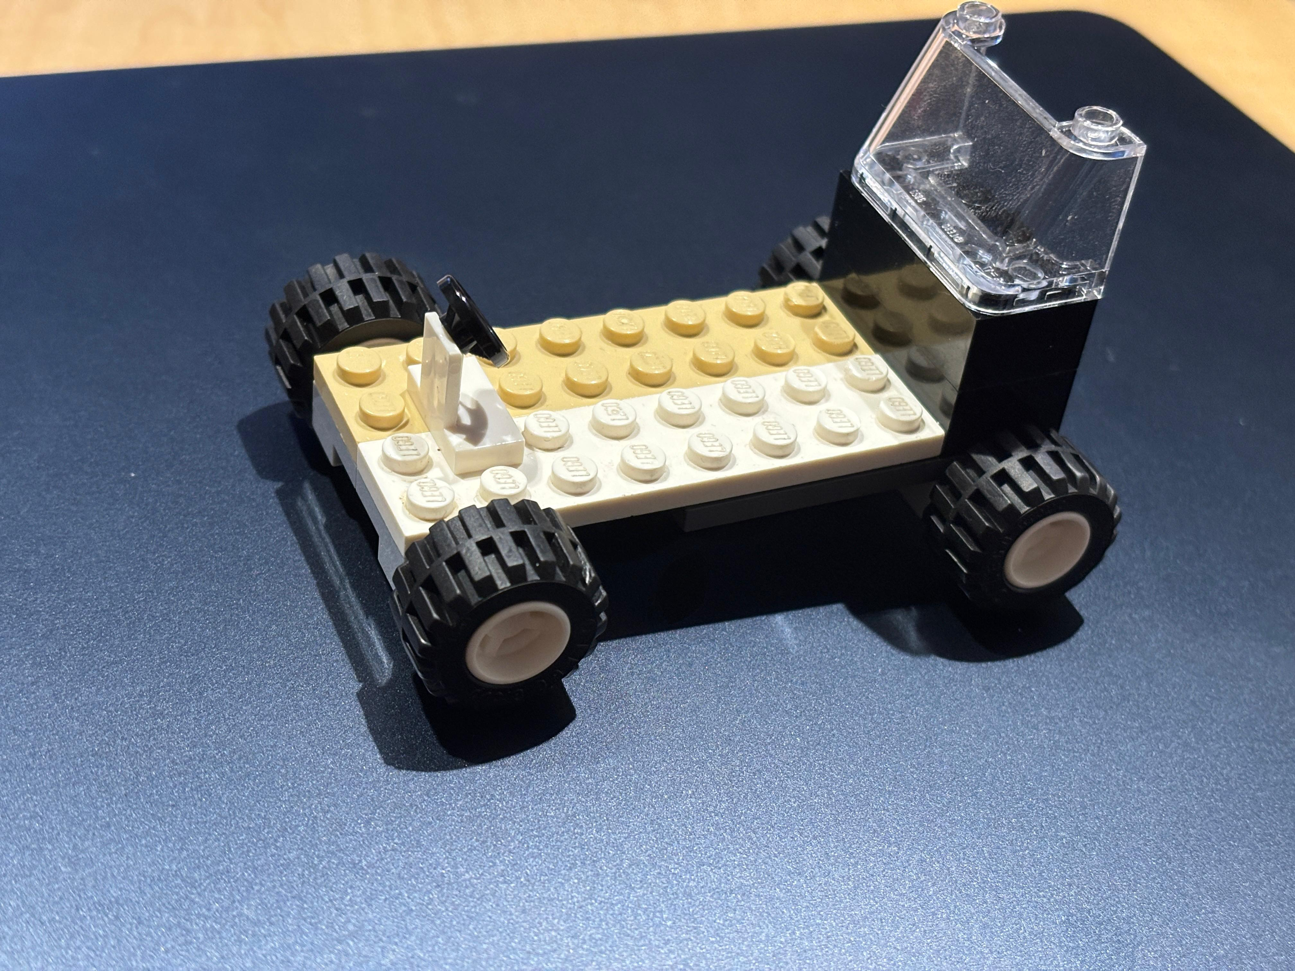
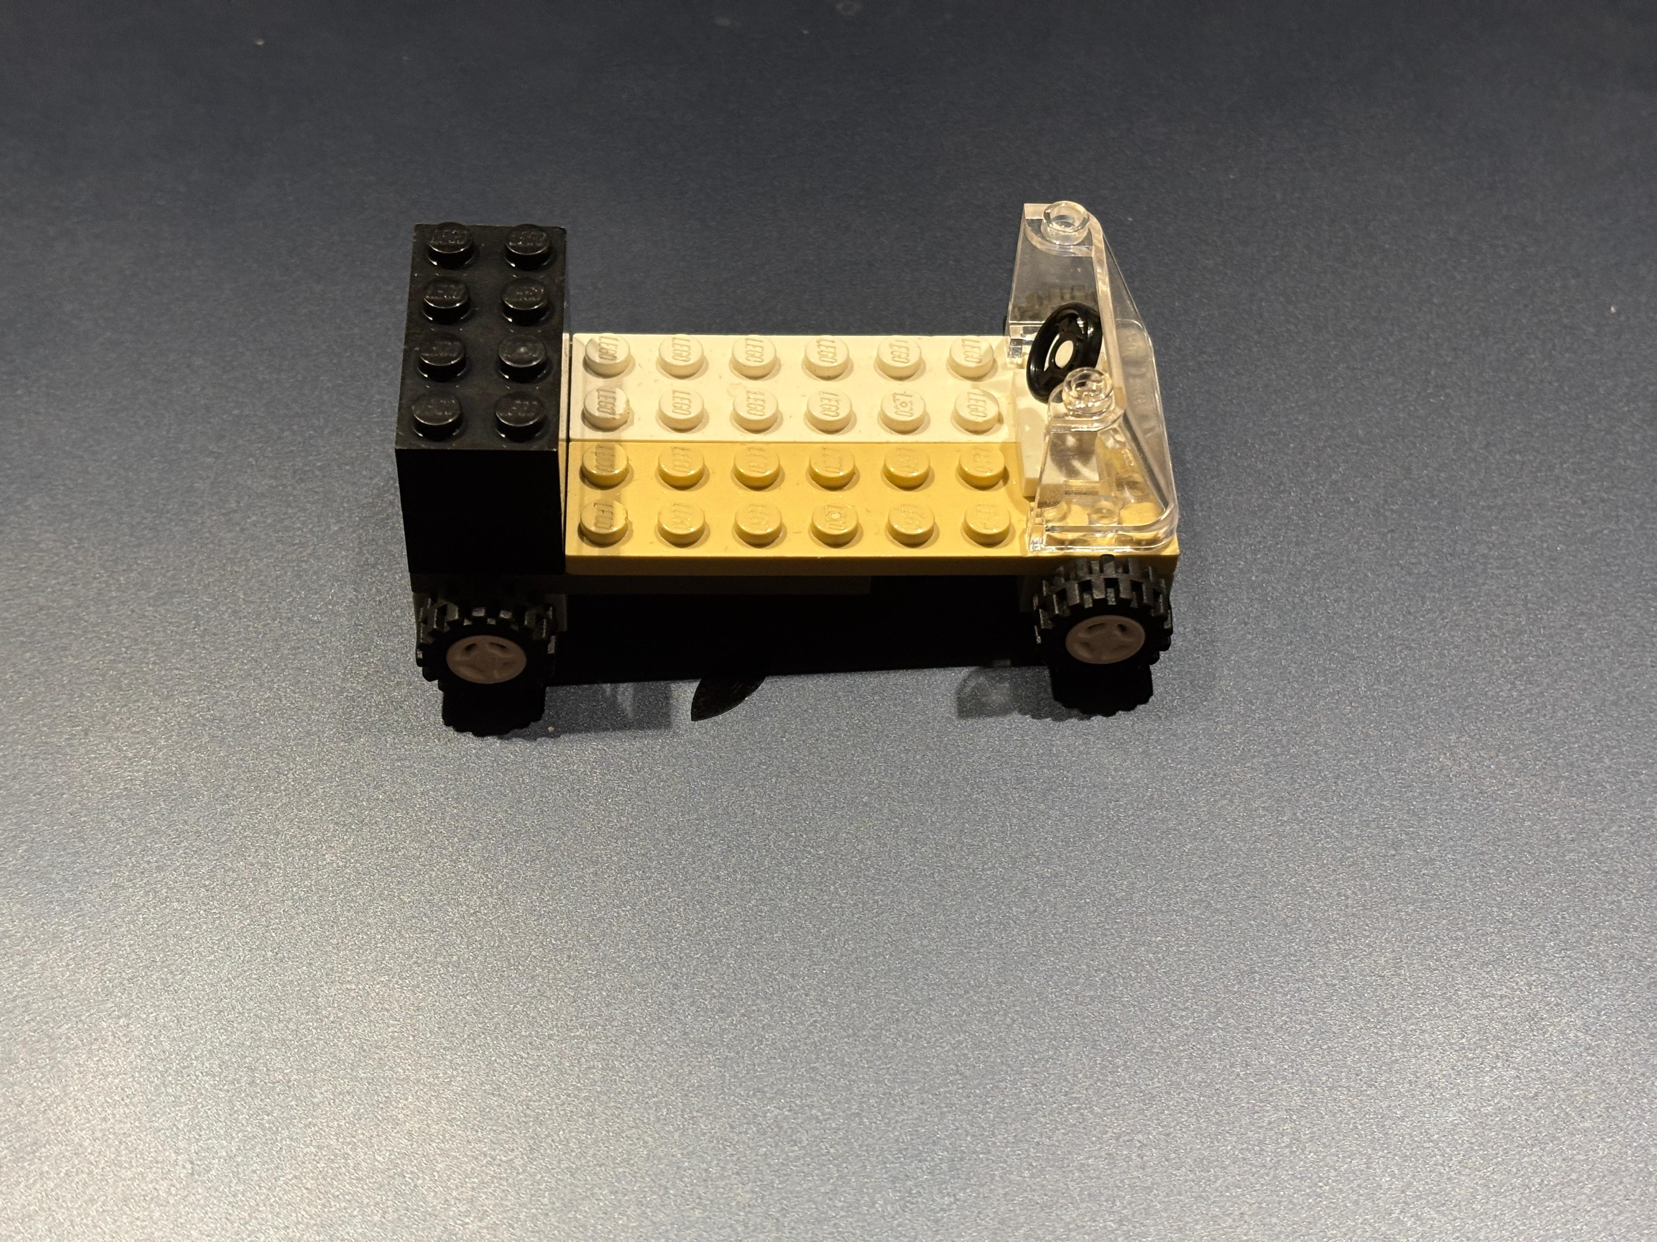

Types of cars
Worst performing car
Best performing car

Slide 21

THANK YOU

